Slide 1
“Socialize” = Social + Optimize
Using Data Science to optimize social media engagement
Jessica Chau
Ishaan Jaffer

Slide 2
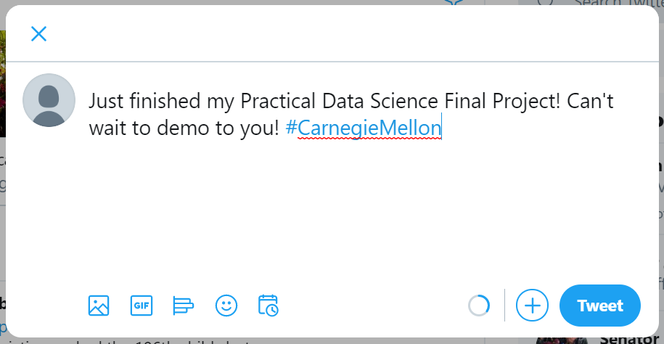
Optimizations for a tweet
Best time to post
What hashtags to use
Popular Keywords
Sentiment Analysis

Slide 3
Data Science Pipeline
User enters tweet
content they intend on
using, and category of
their tweet
Identify keywords and rank importance of each word based on the given category from webscraping
Gather data on the global activity of tweets with those keywords from the Twitter API
Use Pandas to predict the interval of time when the Twitter users are most active globally
Use NLTK to analyze the sentiment of the given Tweet content
Gather data on the activity of the user’s followers from the Twitter API
Identify the hashtags that are associated with the most popular tweets globally
Identify the hashtags that are associated with the most popular tweets from the user’s followers
Use Pandas to predict the interval of time when the user’s followers are most active

